Slide 1
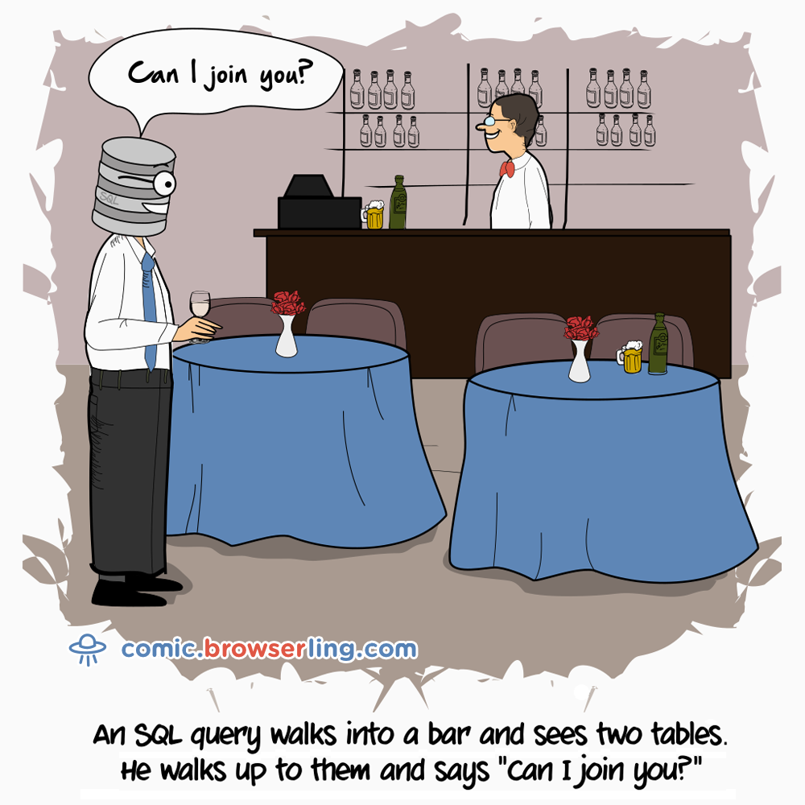
CS50 Section 7:
SQL
Albert
https://www.sli.do/
Code: 21384

Slide 2
In order to build increasingly complex websites, we depend on a database to store information long-term. The simplest form of a database with which we are all likely familiar is a basic spreadsheet, organized into rows and columns, tabs (tables), and individual files (databases).
SQL is a programming language whose purpose is to query databases (perform operations on them).

Slide 3
After you create a database, you create one or more tables.
For each table, you specify all of the columns in the table.
When new information is added to the database, the new information (typically) goes into a new row.
There are many data types that can be stored in a SQL database. This is just a small sample.
INT | SMALLINT | TINYINT | MEDIUMINT | BIGINT
DECIMAL | FLOAT | BIT | DATE | TIME
DATETIME | TIMESTAMP | CHAR | VARCHAR | BINARY
BLOB | TEXT | ENUM | GEOMETRY | LINESTRING

Slide 4
After you create a database, you create one or more tables.
For each table, you specify all of the columns in the table.
When new information is added to the database, the new information (typically) goes into a new row.
In SQLite, which we’ll use in this course, we can consolidate these various datatypes into a few more general classes (though underlying types still exist)
NULL | INTEGER | REAL | TEXT | BLOB

Slide 5
Another consideration is choosing a column to be a primary key, guaranteed to be unique across rows. A good primary key makes subsequent table operations much easier.
You can also have a joint primary key, a combination of two or more columns where the combination is guaranteed to be unique.
SQL is a programming language, but it has a limited vocabulary that we’ll use.

Slide 6
Another consideration is choosing a column to be a primary key, guaranteed to be unique across rows. A good primary key makes subsequent table operations much easier.
You can also have a joint primary key, a combination of two or more columns where the combination is guaranteed to be unique.
SQL is a programming language, but it has a limited vocabulary that we’ll use.
INSERT
SELECT
UPDATE
DELETE

Slide 7
users
moms
idnum | username | password | fullname
10 | jerry | fus!ll! | Jerry Seinfeld
11 | gcostanza | b0sc0 | George Costanza
username | mother
jerry | Helen Seinfeld
gcostanza | Estelle Costanza

Slide 8
An INSERT query adds information to a table.
INSERT INTO
<table>
(<columns>)
VALUES
(<values>)

Slide 9
An INSERT query adds information to a table.
INSERT INTO
users
(username, password, fullname)
VALUES
('newman', 'USMAIL', 'Newman')

Slide 10
An INSERT query adds information to a table.
INSERT INTO
users
(username, password, fullname)
VALUES
('newman', 'USMAIL', 'Newman')
Inserts ‘newman’, ‘USMAIL’, ‘Newman’ into the username, password, fullname columns (respectively) in the users table

Slide 11
users
moms
idnum | username | password | fullname
10 | jerry | fus!ll! | Jerry Seinfeld
11 | gcostanza | b0sc0 | George Costanza
12 | newman | USMAIL | Newman
username | mother
jerry | Helen Seinfeld
gcostanza | Estelle Costanza
INSERT INTO
users
(username, password, fullname)
VALUES
('newman', 'USMAIL', 'Newman')

Slide 12
users
moms
idnum | username | password | fullname
10 | jerry | fus!ll! | Jerry Seinfeld
11 | gcostanza | b0sc0 | George Costanza
12 | newman | USMAIL | Newman
username | mother
jerry | Helen Seinfeld
gcostanza | Estelle Costanza
INSERT INTO
users
(username, password, fullname)
VALUES
('newman', 'USMAIL', 'Newman')

Slide 13
When defining the column that ultimately is your primary key, it’s usually a good idea for that column to be an integer.
Moreover, you can configure that column to autoincrement, so it will pre-populate that column for you automatically when rows are added, eliminating the risk that you’ll accidentally try to insert something with a duplicate value.

Slide 14
An INSERT query adds information to a table.
INSERT INTO
moms
(username, mother)
VALUES
('kramer', 'Babs Kramer')

Slide 15
An INSERT query adds information to a table.
INSERT INTO
moms
(username, mother)
VALUES
('kramer', 'Babs Kramer')
Inserts ‘kramer’, ‘mother’ into the username, mother columns (respectively) in the moms table

Slide 16
users
moms
idnum | username | password | fullname
10 | jerry | fus!ll! | Jerry Seinfeld
11 | gcostanza | b0sc0 | George Costanza
12 | newman | USMAIL | Newman
username | mother
jerry | Helen Seinfeld
gcostanza | Estelle Costanza
kramer | Babs Kramer
INSERT INTO
moms
(username, mother)
VALUES
('kramer', 'Babs Kramer')

Slide 17
A SELECT query extracts information from a table.
SELECT
<columns>
FROM
<table>
WHERE
<predicate>

Slide 18
A SELECT query extracts information from a table.
SELECT
idnum, fullname
FROM
users

Slide 19
A SELECT query extracts information from a table.
SELECT
idnum, fullname
FROM
users
Selects all idnums and fullnames from the users table

Slide 20
users
moms
idnum | username | password | fullname
10 | jerry | fus!ll! | Jerry Seinfeld
11 | gcostanza | b0sc0 | George Costanza
12 | newman | USMAIL | Newman
username | mother
jerry | Helen Seinfeld
gcostanza | Estelle Costanza
kramer | Babs Kramer
SELECT
idnum, fullname
FROM
users

Slide 21
users
moms
idnum | username | password | fullname
10 | jerry | fus!ll! | Jerry Seinfeld
11 | gcostanza | b0sc0 | George Costanza
12 | newman | USMAIL | Newman
username | mother
jerry | Helen Seinfeld
gcostanza | Estelle Costanza
kramer | Babs Kramer
SELECT
idnum, fullname
FROM
users

Slide 22
A SELECT query extracts information from a table.
SELECT
password
FROM
users
WHERE
idnum < 12

Slide 23
A SELECT query extracts information from a table.
SELECT
password
FROM
users
WHERE
idnum < 12
Selects passwords from the users table where the idnums are less than 12

Slide 24
users
moms
idnum | username | password | fullname
10 | jerry | fus!ll! | Jerry Seinfeld
11 | gcostanza | b0sc0 | George Costanza
12 | newman | USMAIL | Newman
SELECT
password
FROM
users
WHERE
idnum < 12
username | mother
jerry | Helen Seinfeld
gcostanza | Estelle Costanza
kramer | Babs Kramer

Slide 25
users
moms
idnum | username | password | fullname
10 | jerry | fus!ll! | Jerry Seinfeld
11 | gcostanza | b0sc0 | George Costanza
12 | newman | USMAIL | Newman
SELECT
password
FROM
users
WHERE
idnum < 12
username | mother
jerry | Helen Seinfeld
gcostanza | Estelle Costanza
kramer | Babs Kramer

Slide 26
A SELECT query extracts information from a table.
SELECT
*
FROM
moms
WHERE
username = 'jerry'

Slide 27
A SELECT query extracts information from a table.
SELECT
*
FROM
moms
WHERE
username = 'jerry'
Selects all fields in rows where username is ‘jerry’ (from moms table)

Slide 28
users
moms
idnum | username | password | fullname
10 | jerry | fus!ll! | Jerry Seinfeld
11 | gcostanza | b0sc0 | George Costanza
12 | newman | USMAIL | Newman
SELECT
*
FROM
moms
WHERE
username = 'jerry'
username | mother
jerry | Helen Seinfeld
gcostanza | Estelle Costanza
kramer | Babs Kramer

Slide 29
users
moms
idnum | username | password | fullname
10 | jerry | fus!ll! | Jerry Seinfeld
11 | gcostanza | b0sc0 | George Costanza
12 | newman | USMAIL | Newman
SELECT
*
FROM
moms
WHERE
username = 'jerry'
username | mother
jerry | Helen Seinfeld
gcostanza | Estelle Costanza
kramer | Babs Kramer

Slide 30
An UPDATE query modifies information in a table.
UPDATE
<table>
SET
<column> = <value>
WHERE
<predicate>

Slide 31
An UPDATE query modifies information in a table.
UPDATE
users
SET
password = 'yadayada'
WHERE
idnum = 10

Slide 32
An UPDATE query modifies information in a table.
UPDATE
users
SET
password = 'yadayada'
WHERE
idnum = 10
Updates the password of the user with idnum = 10 to ‘yadayada’

Slide 33
users
moms
idnum | username | password | fullname
10 | jerry | yadayada | Jerry Seinfeld
11 | gcostanza | b0sc0 | George Costanza
12 | newman | USMAIL | Newman
username | mother
jerry | Helen Seinfeld
gcostanza | Estelle Costanza
kramer | Babs Kramer
UPDATE
users
SET
password = 'yadayada'
WHERE
idnum = 10

Slide 34
users
moms
idnum | username | password | fullname
10 | jerry | yadayada | Jerry Seinfeld
11 | gcostanza | b0sc0 | George Costanza
12 | newman | USMAIL | Newman
username | mother
jerry | Helen Seinfeld
gcostanza | Estelle Costanza
kramer | Babs Kramer
UPDATE
users
SET
password = 'yadayada'
WHERE
idnum = 10

Slide 35
Databases empower us to organize information into tables efficiently.
We don’t always need to store every possible relevant piece of information in the same table, but rather we can use relationships across tables to connect all the pieces of data we need.
Let’s imagine we need to get a user’s full name (from the users table) and their mother’s name (from the moms table).

Slide 36
A nested SELECT query extracts information that can only be obtained using multiple tables.
SELECT
<columns>
FROM
<table1>
WHERE <field> = (Another SELECT from table 2)

Slide 37
A nested SELECT query extracts information that can only be obtained using multiple tables.
SELECT
mother
FROM
moms
WHERE
username = (SELECT username FROM users WHERE fullname = ‘Jerry Seinfield’);

Slide 38
A nested SELECT query extracts information that can only be obtained using multiple tables.
SELECT
mother
FROM
moms
WHERE
username = (SELECT username FROM users WHERE fullname = ‘Jerry Seinfield’);
Selects the mother who has the same username as Jerry Seinfield

Slide 39
users
moms
idnum | username | password | fullname
10 | jerry | fus!ll! | Jerry Seinfeld
11 | gcostanza | b0sc0 | George Costanza
12 | newman | USMAIL | Newman
SELECT
mother
FROM
moms
WHERE
username = (SELECT username FROM users WHERE fullname = ‘Jerry Seinfield’);
username | mother
jerry | Helen Seinfeld
gcostanza | Estelle Costanza
kramer | Babs Kramer

Slide 40
users
moms
idnum | username | password | fullname
10 | jerry | fus!ll! | Jerry Seinfeld
11 | gcostanza | b0sc0 | George Costanza
12 | newman | USMAIL | Newman
SELECT
mother
FROM
moms
WHERE
username = (SELECT username FROM users WHERE fullname = ‘Jerry Seinfield’);
username | mother
jerry | Helen Seinfeld
gcostanza | Estelle Costanza
kramer | Babs Kramer

Slide 41
users
moms
idnum | username | password | fullname
10 | jerry | fus!ll! | Jerry Seinfeld
11 | gcostanza | b0sc0 | George Costanza
12 | newman | USMAIL | Newman
SELECT
mother
FROM
moms
WHERE
username = (SELECT username FROM users WHERE fullname = ‘Jerry Seinfield’);
username | mother
jerry | Helen Seinfeld
gcostanza | Estelle Costanza
kramer | Babs Kramer

Slide 42
A SELECT (JOIN) query extracts information from multiple tables.
SELECT
<columns>
FROM
<table1>
JOIN
<table2>
ON
<predicate>

Slide 43
A SELECT (JOIN) query extracts information from multiple tables.
SELECT
users.fullname, moms.mother
FROM
users
JOIN
moms
ON
users.username = moms.username

Slide 44
A SELECT (JOIN) query extracts information from multiple tables.
SELECT
users.fullname, moms.mother
FROM
users
JOIN
moms
ON
users.username = moms.username

Slide 45
users
moms
idnum | username | password | fullname
10 | jerry | fus!ll! | Jerry Seinfeld
11 | gcostanza | b0sc0 | George Costanza
12 | newman | USMAIL | Newman
username | mother
jerry | Helen Seinfeld
gcostanza | Estelle Costanza
kramer | Babs Kramer
SELECT
users.fullname, moms.mother
FROM
users
JOIN
moms
ON
users.username = moms.username

Slide 46
users
moms
idnum | username | password | fullname
10 | jerry | fus!ll! | Jerry Seinfeld
11 | gcostanza | b0sc0 | George Costanza
12 | newman | USMAIL | Newman
username | mother
jerry | Helen Seinfeld
gcostanza | Estelle Costanza
kramer | Babs Kramer
SELECT
users.fullname, moms.mother
FROM
users
JOIN
moms
ON
users.username = moms.username

Slide 47
users
moms
idnum | username | password | fullname
10 | jerry | fus!ll! | Jerry Seinfeld
11 | gcostanza | b0sc0 | George Costanza
12 | newman | USMAIL | Newman
username | mother
jerry | Helen Seinfeld
gcostanza | Estelle Costanza
kramer | Babs Kramer
SELECT
users.fullname, moms.mother
FROM
users
JOIN
moms
ON
users.username = moms.username

Slide 48
users & moms
users.idnum | users.username moms.username | users.password | users.fullname | moms.mother
10 | jerry | fus!ll! | Jerry Seinfeld | Helen Seinfeld
11 | gcostanza | b0sc0 | George Costanza | Estelle Costanza
SELECT
users.fullname, moms.mother
FROM
users
JOIN
moms
ON
users.username = moms.username

Slide 49
users & moms
users.idnum | users.username moms.username | users.password | users.fullname | moms.mother
10 | jerry | fus!ll! | Jerry Seinfeld | Helen Seinfeld
11 | gcostanza | b0sc0 | George Costanza | Estelle Costanza
SELECT
users.fullname, moms.mother
FROM
users
JOIN
moms
ON
users.username = moms.username

Slide 50
An UPDATE query modifies information in a table.
UPDATE
<table>
SET
<column> = <value>
WHERE
<predicate>

Slide 51
An UPDATE query modifies information in a table.
UPDATE
users
SET
password = 'yadayada'
WHERE
idnum = 10

Slide 52
An UPDATE query modifies information in a table.
UPDATE
users
SET
password = 'yadayada'
WHERE
idnum = 10
Updates the password of the user with idnum = 10 to ‘yadayada’

Slide 53
users
moms
idnum | username | password | fullname
10 | jerry | yadayada | Jerry Seinfeld
11 | gcostanza | b0sc0 | George Costanza
12 | newman | USMAIL | Newman
username | mother
jerry | Helen Seinfeld
gcostanza | Estelle Costanza
kramer | Babs Kramer
UPDATE
users
SET
password = 'yadayada'
WHERE
idnum = 10

Slide 54
users
moms
idnum | username | password | fullname
10 | jerry | yadayada | Jerry Seinfeld
11 | gcostanza | b0sc0 | George Costanza
12 | newman | USMAIL | Newman
username | mother
jerry | Helen Seinfeld
gcostanza | Estelle Costanza
kramer | Babs Kramer
UPDATE
users
SET
password = 'yadayada'
WHERE
idnum = 10

Slide 55
A DELETE query removes information from a table.
DELETE FROM
<table>
WHERE
<predicate>

Slide 56
A DELETE query removes information from a table.
DELETE FROM
users
WHERE
username = 'newman'

Slide 57
A DELETE query removes information from a table.
DELETE FROM
users
WHERE
username = 'newman'
Deletes the row where a user has username ‘newman’

Slide 58
users
moms
idnum | username | password | fullname
10 | jerry | fus!ll! | Jerry Seinfeld
11 | gcostanza | b0sc0 | George Costanza
12 | newman | USMAIL | Newman
username | mother
jerry | Helen Seinfeld
gcostanza | Estelle Costanza
kramer | Babs Kramer
DELETE FROM
users
WHERE
username = 'newman'

Slide 59
users
moms
idnum | username | password | fullname
10 | jerry | fus!ll! | Jerry Seinfeld
11 | gcostanza | b0sc0 | George Costanza
username | mother
jerry | Helen Seinfeld
gcostanza | Estelle Costanza
kramer | Babs Kramer
DELETE FROM
users
WHERE
username = 'newman'

Slide 60
Useful Resource
W3Schools:
https://www.w3schools.com/sql/sql_ref_keywords.asp

Slide 61
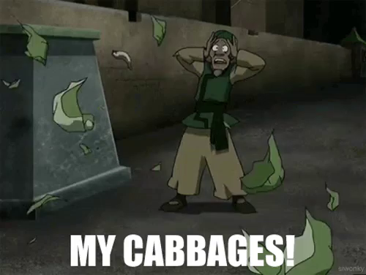
Practice: Cabbages
Credits to Josh Archibald

Slide 62

Practice: Cabbages

Slide 63
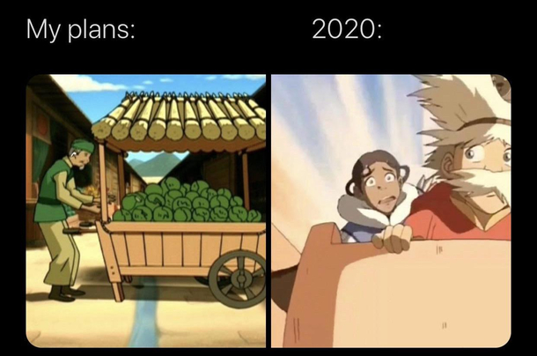
Practice: Cabbages

Slide 64
Practice: Cabbages
1. Create a database.
Create a database called cabbages.db.
touch cabbages.db

Slide 65
Practice: Cabbages
2. Open the database in SQLite.
sqlite3 cabbages.db

Slide 66
Practice: Cabbages
3. Create some tables.
Let's get this database started! Cabbage Man is hoping to have 3 tables to get off the ground:
customers
id (INTEGER, PRIMARY KEY)
name (TEXT, NOT NULL)
email (TEXT, NOT NULL)
invoices
id (INTEGER, PRIMARY KEY)
customer_id (INTEGER, NOT NULL)
total_value (REAL, NOT NULL)
cabbages
id (INTEGER, PRIMARY KEY)
cabbage_type (TEXT, NOT NULL)
batch_id (INTEGER, NOT NULL)
invoice_id (INTEGER, NOT NULL)
value (REAL, NOT NULL)

Slide 67
Practice: Cabbages
4. Inserting some data into the database.
We will practice INSERT by adding some customers
Name | Email
Aang | aang@team.avatar
Iroh | iroh@fire.gov
Katara | katara@team.avatar
Sokka | sokka@team.avatar
Toph | toph@team.avatar
Zuko | zuko@fire.gov

Slide 68
Practice: Cabbages
5a. Simulate some cabbage purchases.
Download simulate.py from this folder: https://drive.google.com/drive/folders/1Zn1dIEn4mKi6fOxVMIb15yA_XHk1kcHU?usp=sharing
Upload it to your IDE and run it (python simulate.py) to add more customers, cabbages, and invoices to your tables!

Slide 69
Practice: Cabbages
5b. Switch to SQL files for the rest of this.
We're going to be writing some longer SQL statements for the rest of this exercise, so best to go ahead and create some SQL files so you can edit them and change them incrementally. (Writing longer code in the SQLite program is possible, just tedious.)
touch ozai.sql red.sql recall.sql

Slide 70
Practice: Cabbages
6. The world can't know Ozai likes cabbage. Write in ozai.sql for this part.
The Fire Lord (Ozai) loves cabbage, but he doesn't want there to be any traces of his latest purchases from the cabbage merchant. We have a couple tasks here:
Update any invoices involving the Fire Lord to point to another customer (Iroh), so any audits won't look suspicious.
Delete Ozai's entry (row) in the customers table.

Slide 71
Practice: Cabbages
6. The world can't know Ozai likes cabbage. Write in ozai.sql for this part.
The Fire Lord (Ozai) loves cabbage, but he doesn't want there to be any traces of his latest purchases from the cabbage merchant. We have a couple tasks here:
Update any invoices involving the Fire Lord to point to another customer, so any audits won't look suspicious.
Update any invoices involving the Fire Lord to have Uncle Iroh listed as the customer instead.
Pseudocode: UPDATE invoices SET customer_id = (customer ID of Iroh) WHERE customer_id = (customer ID of Ozai);
Test that you’ve done this correctly by running:
SELECT id FROM invoices WHERE customer_id = (SELECT id FROM customers WHERE name = "Ozai");
What should you see (or not see) as the output?

Slide 72
Practice: Cabbages
6. The world can't know Ozai likes cabbage. Write in ozai.sql for this part.
The Fire Lord (Ozai) loves cabbage, but he doesn't want there to be any traces of his latest purchases from the cabbage merchant. We have a couple tasks here:
Update any invoices involving the Fire Lord to point to another customer, so any audits won't look suspicious.
Update any invoices involving the Fire Lord to have Uncle Iroh listed as the customer instead.
UPDATE invoices SET customer_id = (customer ID of Iroh) WHERE customer_id = (customer ID of Ozai);
Delete Ozai's entry (row) in the customers table.
Verify that you’ve done this correctly by running:
SELECT id FROM customers WHERE name = "Ozai";
Again, what you should see/not see?

Slide 73
Practice: Cabbages
7. The cabbage man wants to keep track of customers who have ordered Red cabbages. Write in red.sql for this part.
Write a SQL query that uses JOIN to list out each customer id and the number of Red cabbages they ordered.
Pseudocode:
SELECT (customer ids), (number of invoices for that customer)
FROM invoices JOIN cabbages ON (id of invoice) = (cabbages with that invoice id)
WHERE (cabbage type is “Red”) GROUP BY (customer ids)

Slide 74
Practice: Cabbages
8. Recall. Use recall.sql to write your answers for this part.
Oh no! Cabbage number 433 has been found to be defective, and we have to recall the entire batch. Ultimately, we want to know 1) how many cabbages were affected, 2) their average (and total) value, and 3) get the names and emails of the customers we should contact about the problem.

Slide 75
Practice: Cabbages
8. Recall. Use recall.sql to write your answers for this part.
Oh no! Cabbage number 433 has been found to be defective, and we have to recall the entire batch. Ultimately, we want to know 1) how many cabbages were affected, 2) their average (and total) value, and 3) get the names and emails of the customers we should contact about the problem.
Pseudocode:
SELECT COUNT(id)
FROM cabbages
WHERE batch_id = (batch ID of cabbage 433);

Slide 76
Practice: Cabbages
8. Recall. Use recall.sql to write your answers for this part.
Oh no! Cabbage number 433 has been found to be defective, and we have to recall the entire batch. Ultimately, we want to know 1) how many cabbages were affected, 2) their average (and total) value, and 3) get the names and emails of the customers we should contact about the problem.
Hint: Try using the AVG and SUM functions

Slide 77
Practice: Cabbages
8. Recall. Use recall.sql to write your answers for this part.
Oh no! Cabbage number 433 has been found to be defective, and we have to recall the entire batch. Ultimately, we want to know 1) how many cabbages were affected, 2) their average (and total) value, and 3) get the names and emails of the customers we should contact about the problem.
Steps:
Get invoice_id of every cabbage in the batch that was sold
Get all distinct customer_id associated with each invoice that may have a bad cabbage (Hint: use DISTINCT function and IN instead of =)
Get name, email of each customer with that customer_id, order alphabetically by name (Hint: use ORDER BY and IN)

Slide 78
Practice: Cabbages
9. Create invoices!
Write a program invoices.py that allows a user to create invoices by inputting their name, email, and total_value of the purchase. In order to create a valid invoice, the following conditions must be satisfied:
The name must be valid (in the customers table)
The email must be valid (in the customers table)
The total_value must be > 0
Print out a success message after inserting

Slide 79

Lab
https://cs50.harvard.edu/college/2020/fall/labs/7/

